Slide 1
AI
CHALLENGE
Venceslas KOUASSI
Lucas BONMARIN

Slide 2
PLAN
2
PROBLEM
STRATEGY
OUR ALGORITHM
RESULTS
OTHER IDEAS

Slide 3
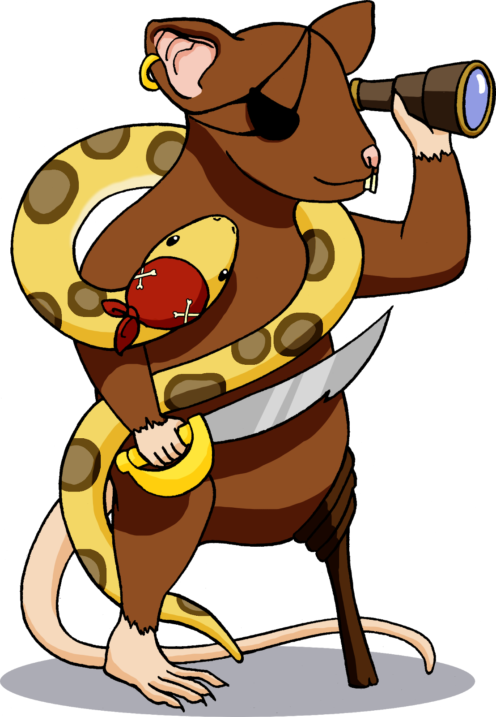
PROBLEM
3
Design an AI algorithmic approach that wins PyRat games against a greedy algorithm (always targeting the closest piece of cheese)
Parameters :
No walls
No mud
Size 21x15
40 pieces of cheese
Non symmetric maze
1000 tests in less than an hour

Slide 4
STRATEGY
4
Reinforcement Learning
Combinatorial Game Theory
Threshold
PoC >Threshold
PoC <= Threshold

Slide 5
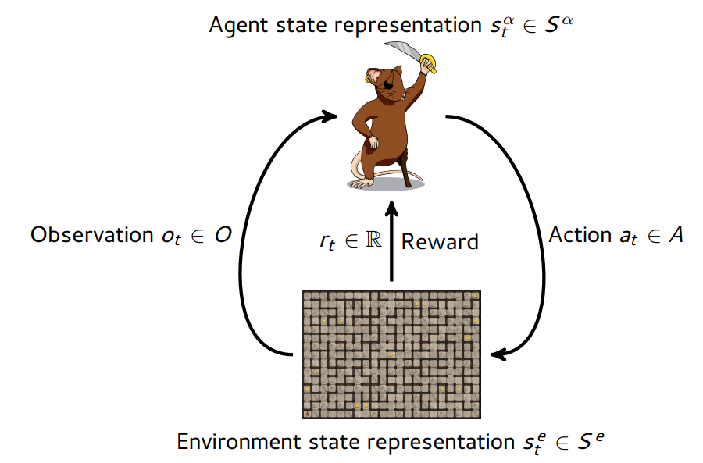
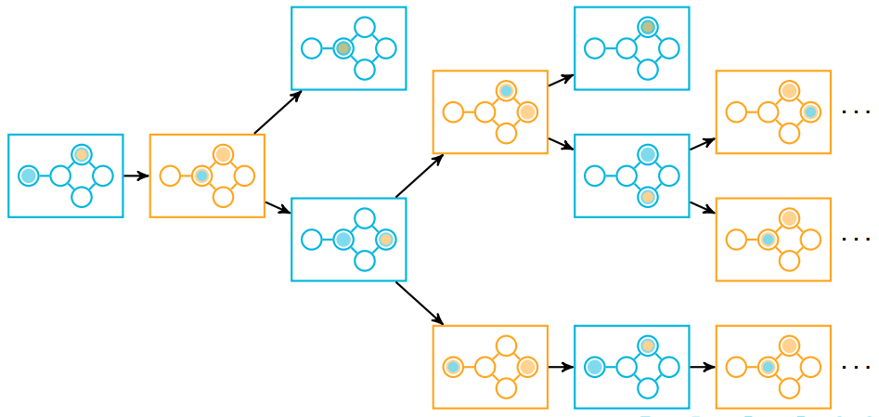
OUR ALGORITHM
5
Reinforcement learning : we just change the number of epochs (6000 -> 8000).
Combinatorial Game Theory: recursive function that goes through the trees of possible plays & takes as arguments a given situation, and return a best target piece of cheese. (very efficient)

Slide 6
RESULTS (1/2)
6
We ran 100 tests for each threshold :

Slide 7
RESULTS (2/2)
7
So we can see that the higher the threshold is, the best score we get.
However, beyond 13, the time to run the algorithm is too long.
Thus, we’ve chosen a threshold of 13.

Slide 8
OTHER IDEAS
8
Cut the maze into 4 parts (or 16), and select the closest part. Then, apply an effective algorithm (like Combinatorial Game Theory) in each part.
In the reinforcement learning, add some parameters for the learning, for example :
- random movements with a probability function
- change the representation of the space
- add the opponent’s position

Slide 9

CONCLUSION
END
17

